Slide 1


Exploratory Data Analysis (Mandatory Task)
TASK SUMMARY
Segment the dataset and draw unique insights, including visualisation of the transaction volume and assessing the effect of any outliers
Notes:
© Copyright Showeet.com – Creative & Free PowerPoint Templates

Slide 2
The RoadMap....
01
Import all Python Libraries
04
Descriptive Statistics
Import dataset
Mean, counts, inferences
02
05
Explore general information
Data cleanup & Transformation
Datatypes, #rows, #column etc.
Missing data, outliers, index
03
Confirm data structure
06
Interesting Insights
Time-series, x-sectional data ?
Tables, plots of interest
Notes:
© Copyright Showeet.com – Creative & Free PowerPoint Templates

Slide 3
General information on dataset….
Rows | columns | Null Values in Dataset
12,043 | 23 | Yes
‘balance’, ‘age’ and ‘amount’ columns are the only true numerical values in the datasets.
‘card_present_flag’ column even though is of the float64 datatype it is actually used as binary categorical data to represent a yes(1) or no (0) as to whether a card was present on the transaction.
The datatypes are strings (object), numbers (float64 & int64) and date and time (datetime64).
Column Names
'status', 'card_present_flag’, bpay_biller_code', 'account'currency', 'long_lat', 'txn_description', 'merchant_id', 'merchant_code', 'first_name', 'balance', 'date', 'gender', 'age’, 'merchant_suburb', 'merchant_state', 'extraction', 'amount', 'transaction_id', 'country', 'customer_id', 'merchant_long_lat’, 'movement'
Notes:
© Copyright Showeet.com – Creative & Free PowerPoint Templates

Slide 4
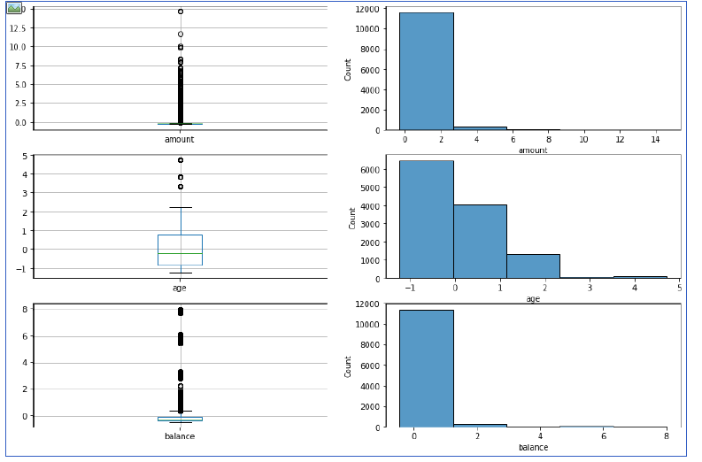
Insights….
Missing Values
Outliers
Columns mostly related to the merchant information
card_present_flag
bpay_biller_code
merchant_id
merchant_code
merchant_suburb
merchant_state
merchant_long_lat
The merchant_code and bpay_biller_code have an almost equal amount of missing values of ~11159 which is ~93% of the entire data instances of 12,043.
There are outliers in the dataset which have values very far from the data population especially for the ‘balance’ and ‘amount’.
.
Notes:
© Copyright Showeet.com – Creative & Free PowerPoint Templates

Slide 5
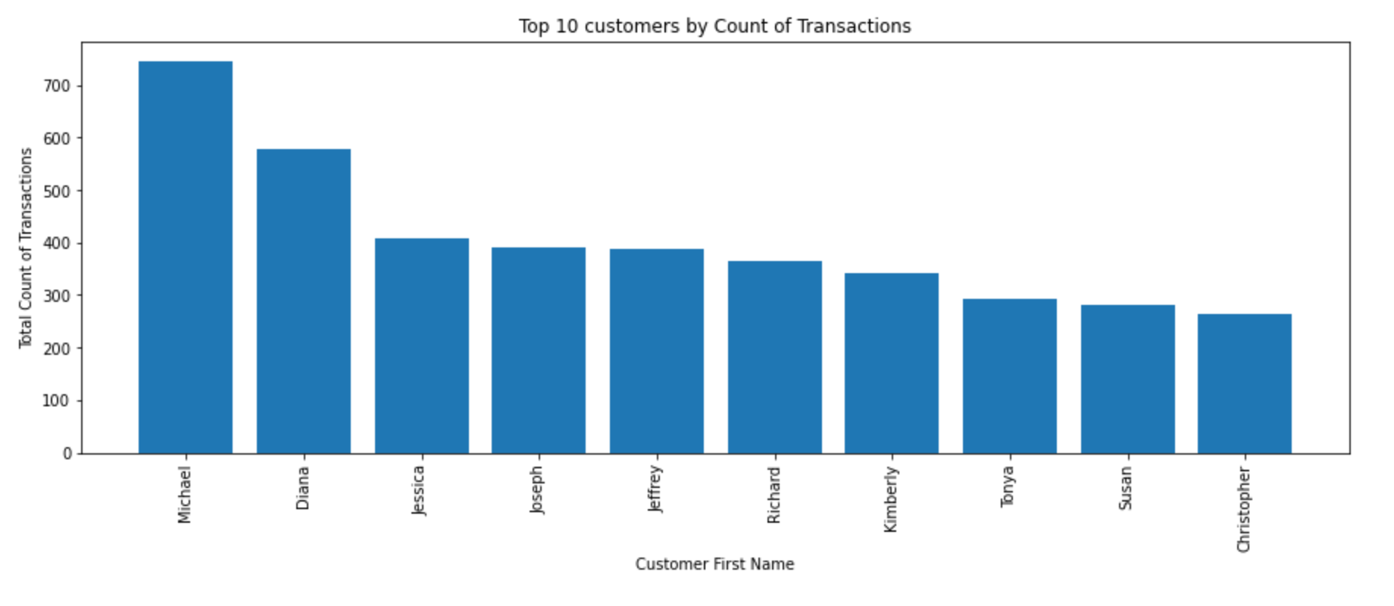
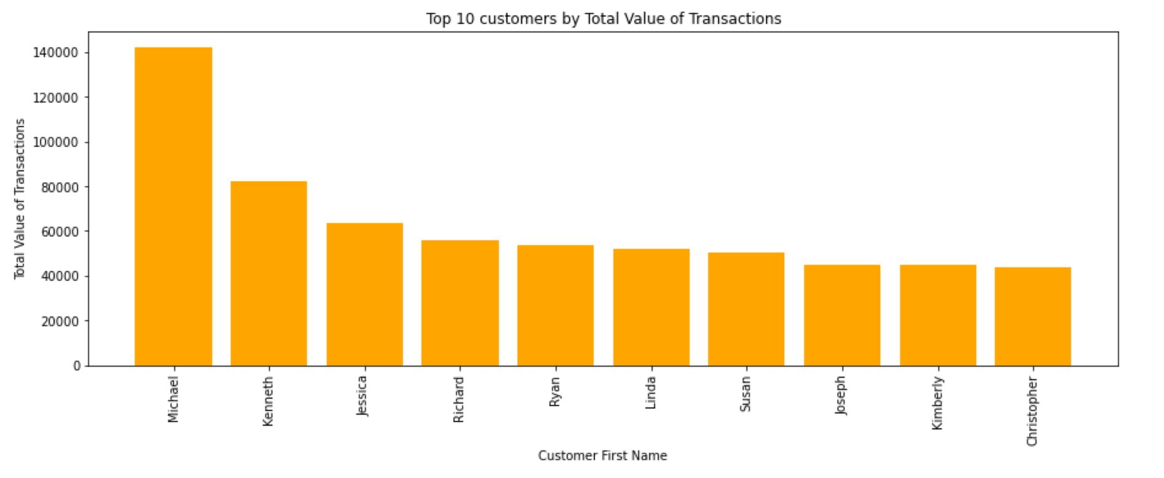
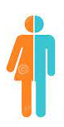
Insights….
Top 10 customers by total count of transactions
Top 10 customers by total value of transactions
39
41
Average age of customers: 31
Average transaction amount is: 187.93
Average balance: AUD 14704.20
Number of customers with transactions
Notes:
© Copyright Showeet.com – Creative & Free PowerPoint Templates

Slide 6
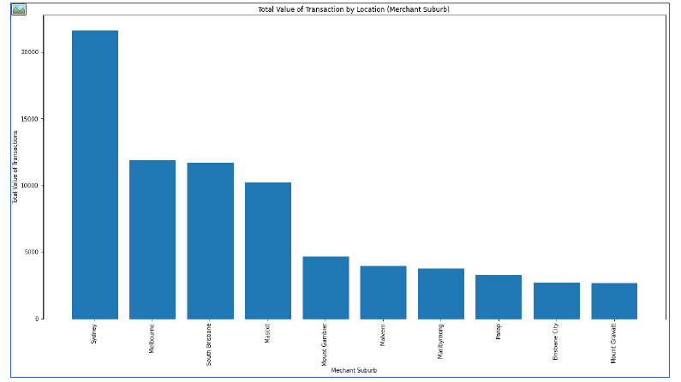
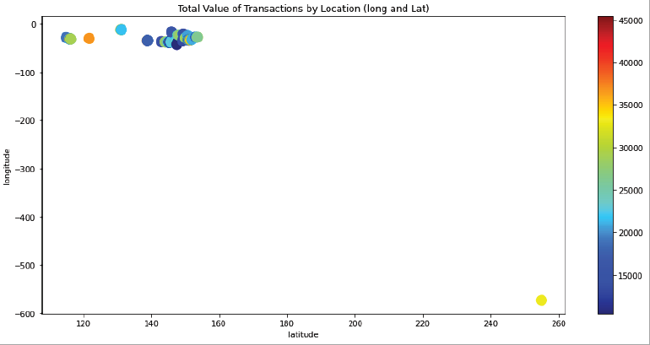
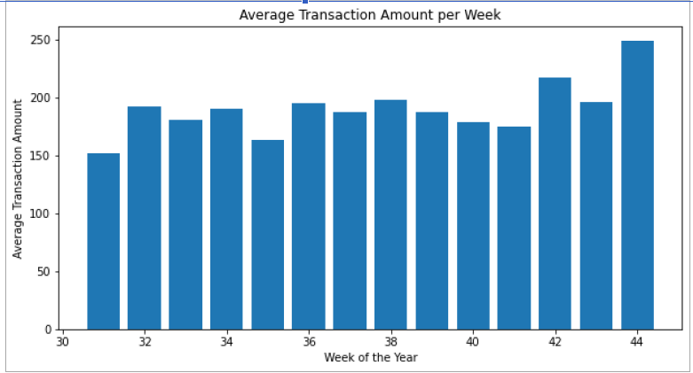
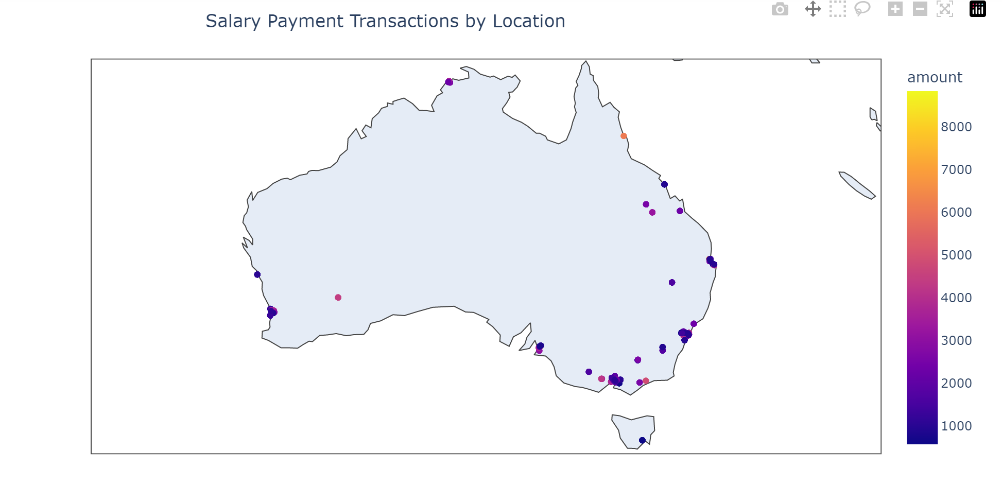
Insights….
The total value of transactions by location (merchant_suburb)
The total value of transactions by location (long and lat)
Average Transaction Amount per Week
Salary Payment by Location
Notes:
© Copyright Showeet.com – Creative & Free PowerPoint Templates

Slide 7
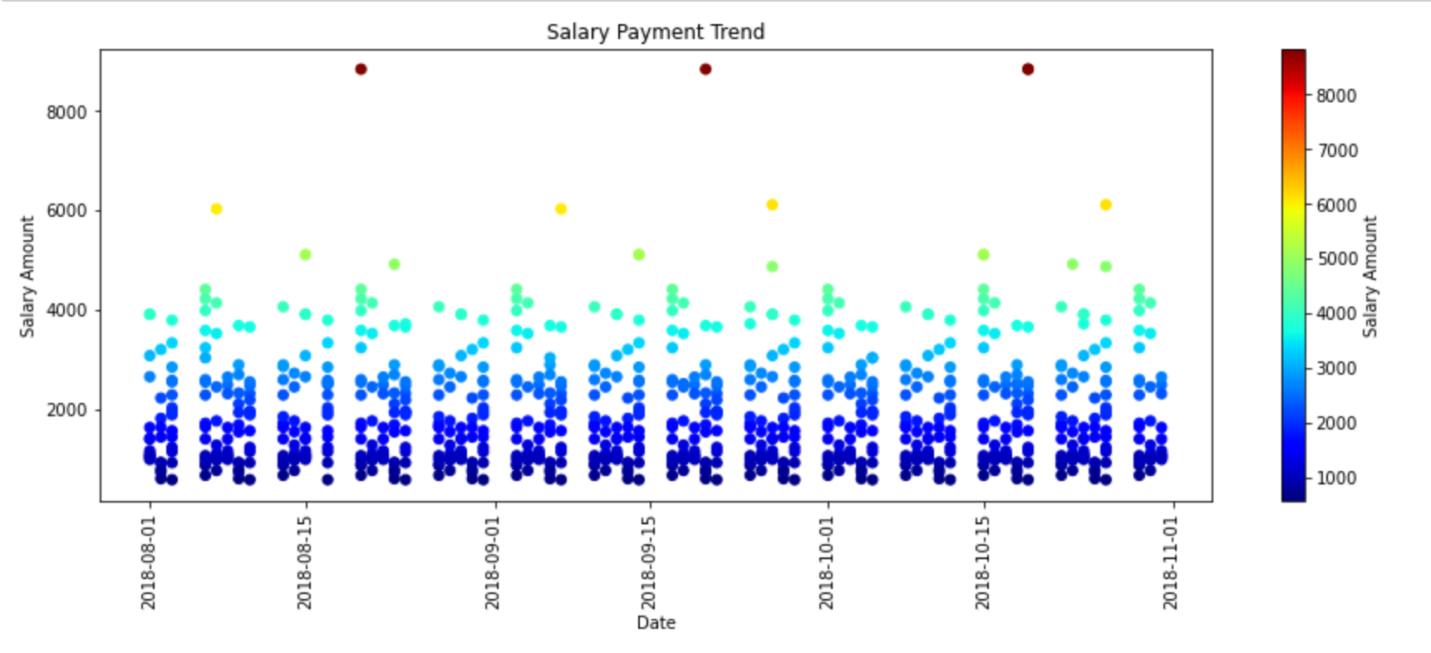
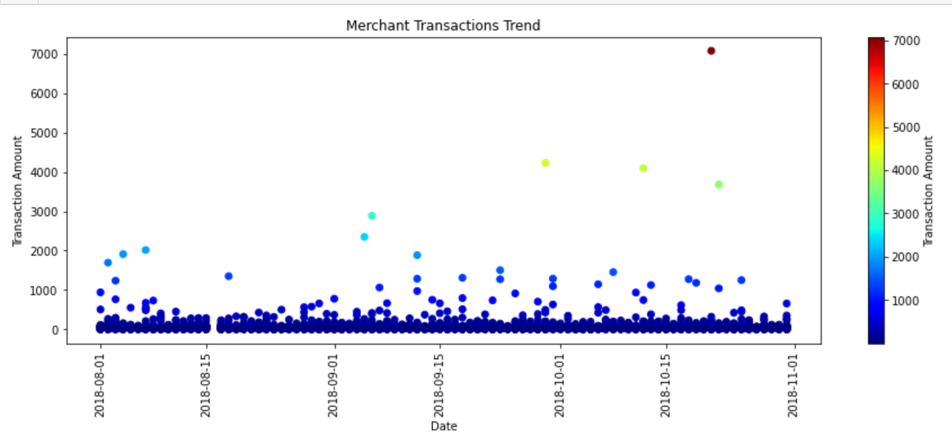
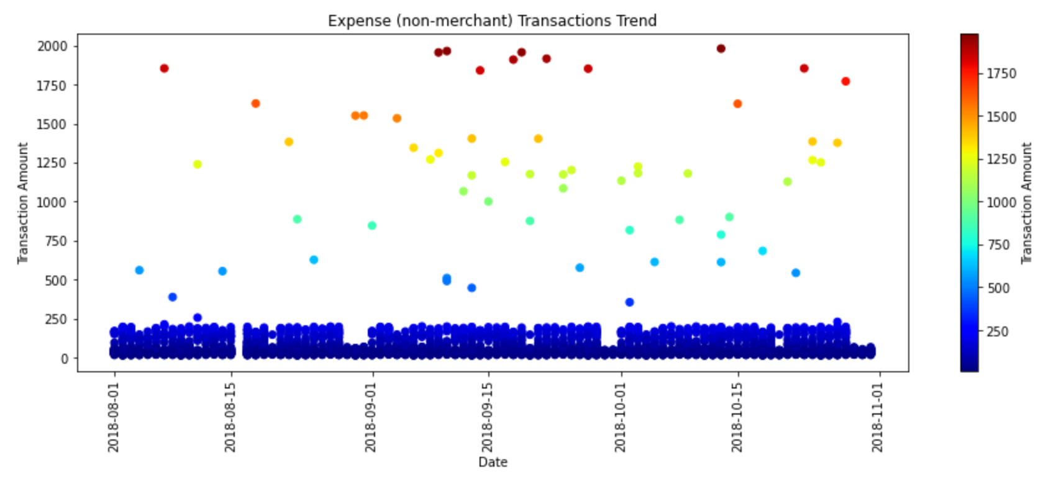
Insights….
Salary Payment Trend
Merchant Purchases Trend
Trend patterns for each type of transaction by the customers:
a) Purchase at merchants (debits)
b) Bills and other payments not done with merchants (debits)
c) Salary payments received (credits)
Non-Merchant Purchases/Bills Trend
Notes:
© Copyright Showeet.com – Creative & Free PowerPoint Templates

Slide 8
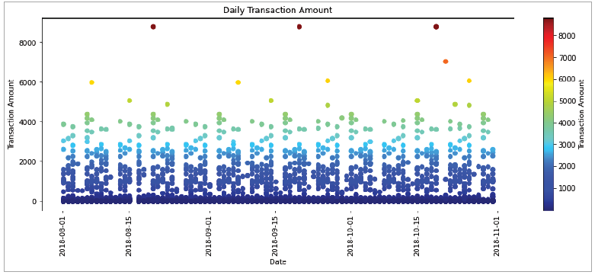
Insights….
The daily pattern of transactions seems to be similar across the three months.
This would be due to monthly recurring transactions.
The highest transaction amounts also occur at similar times in each month (3 points at the top of the plot)
Transaction Amount Trend
Please see attached Jupyter notebook for additional insights.
Soyinka ‘Sho’ Sowoolu PMP
2022
Notes:
© Copyright Showeet.com – Creative & Free PowerPoint Templates

